Slide 1

SmartWallet
CSPC 473-01 - Project 2

Slide 2
Contributors
Stephen Shinn - smshinn@csu.fullerton.edu
Bennett Lawrenz - Spagecko@csu.fullerton.edu
Samarth Shah - samarth_29@csu.fullerton.edu
Rushiraj Jadeja - rushiraj@csu.fullerton.edu
Jiacheng Li - kyle0775168@csu.fullerton.edu

Slide 3
What is SmartWallet?
SmartWallet is a money management webapp which helps users keep track of their spendings throughout the year.
The scope of this webapp will cover: 1) Installation of the Server 2) Configuration of the Database 3) User Features 4) Future Enhancements

Slide 4
Resources Used to Build SmartWallet
React: for web application development
Chart.js: to generate graphics such as charts and graphs
Firebase: sign-in authenticator, database, and hosting

Slide 5
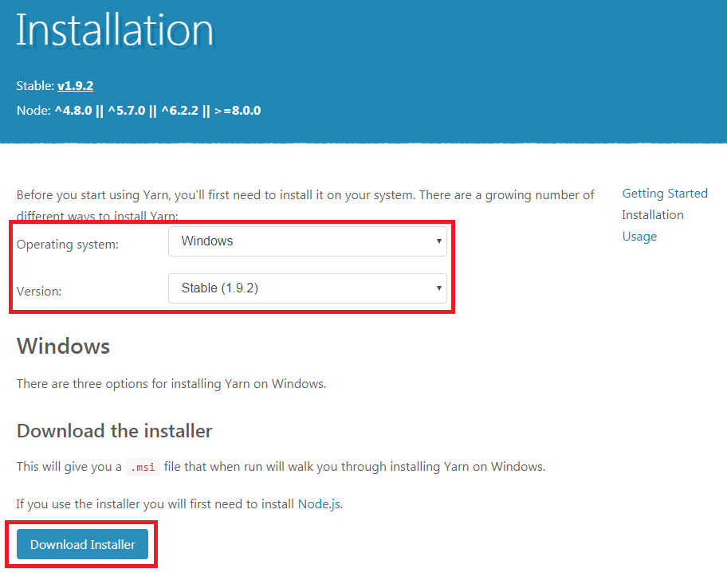
Installation
Install Yarn package manager by going to: https://yarnpkg.com/lang/en/docs/install/#windows-stable

Slide 6
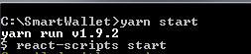
Installation (Cont.)
After Yarn package manager is installed, download SmartWallet from the GitHub repository at: https://github.com/smshinn/SmartWallet
Install the dependencies for SmartWallet by opening Node.js command prompt and navigating to the SmartWallet directory. Then input “yarn install” into the console.
To run the SmartWallet Application, input “yarn start” into the console. IMPORTANT: Make sure Firebase has been configured properly in \SmartWallet\src\firebase\firebase.js (Look up Configuration in the table of contents for further details on how to configure firebase)
The default browser should open and SmartWallet should now be accessible at localhost:3000

Slide 7
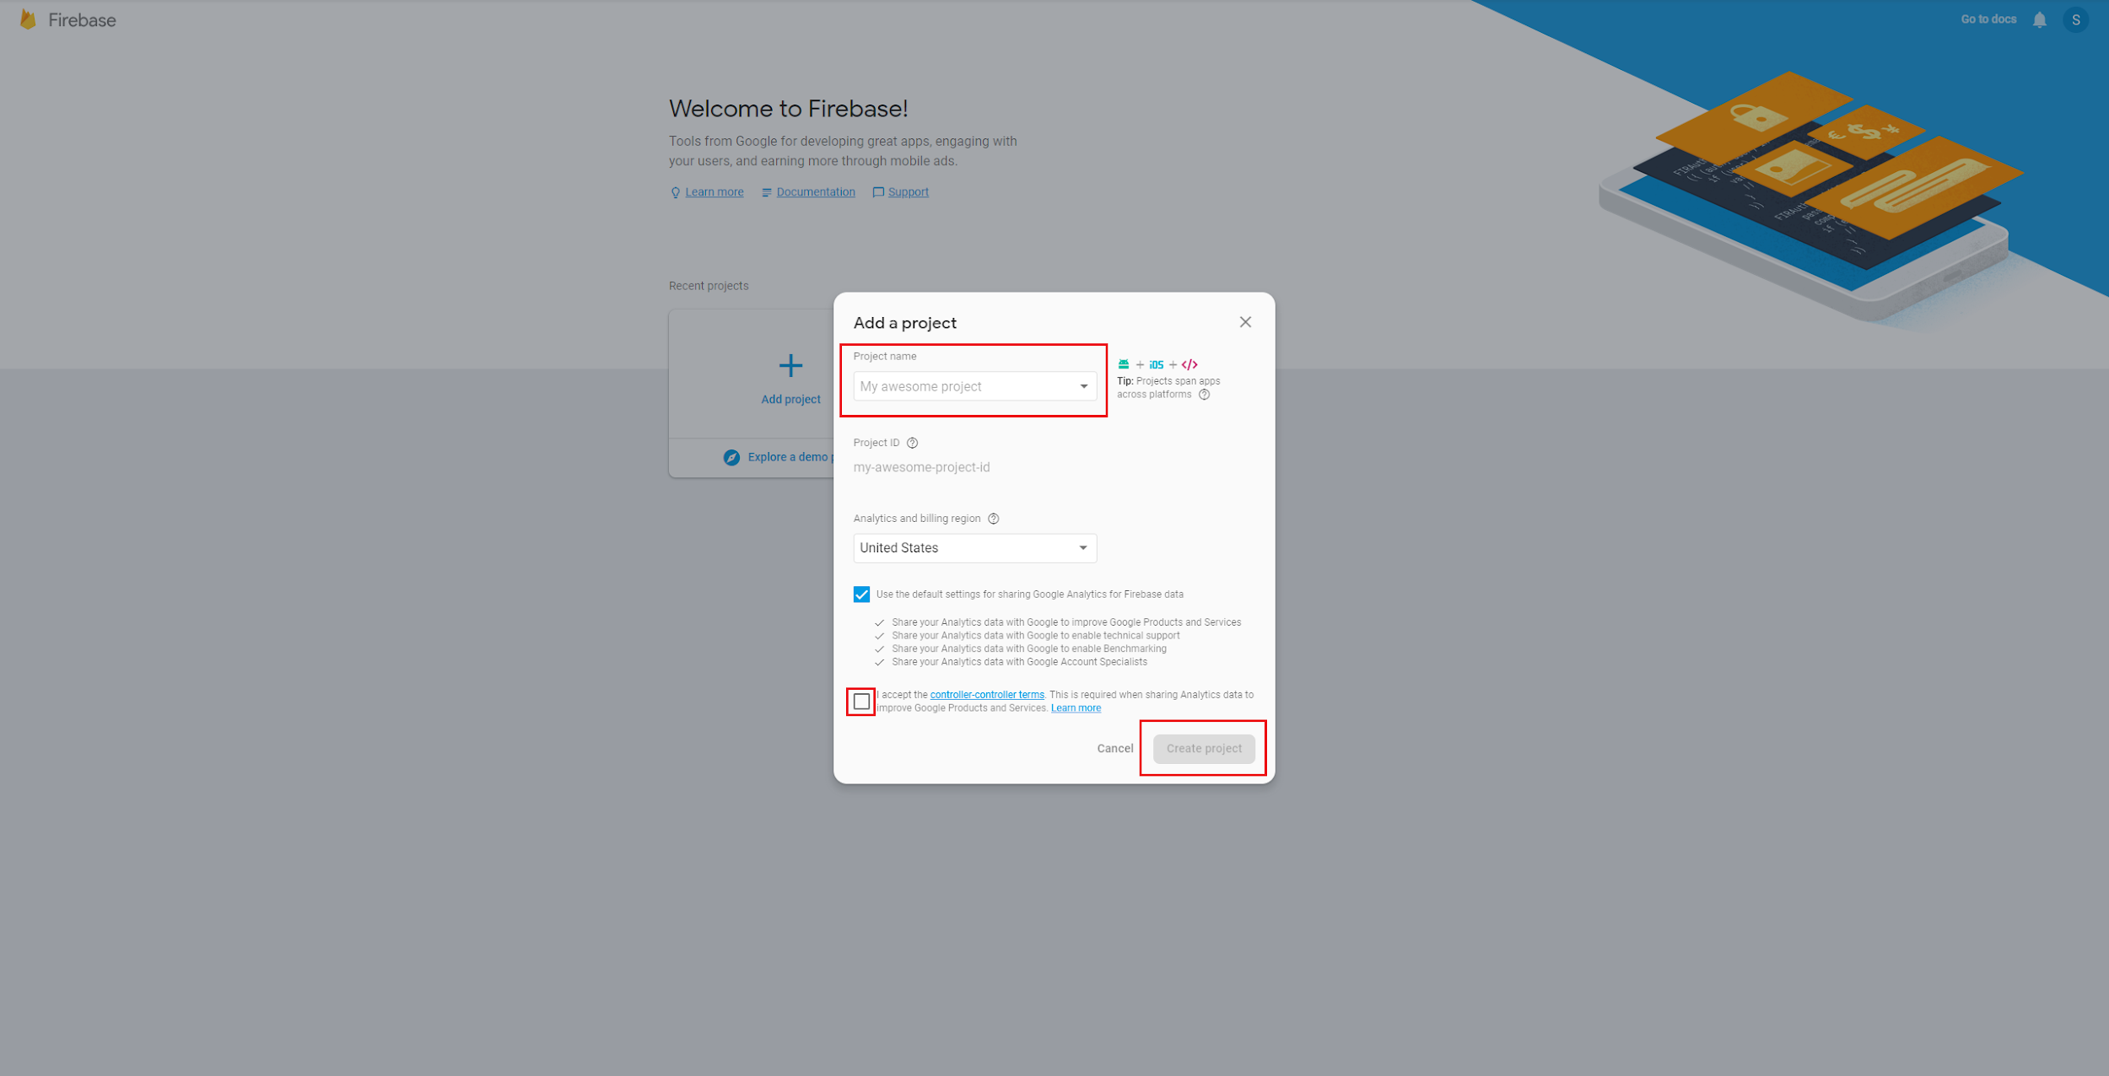
Configuration
Create a firebase project at the link provided: https://console.firebase.google.com
Enter the project name, accept the terms and conditions, and click the “Create Project” button.

Slide 8
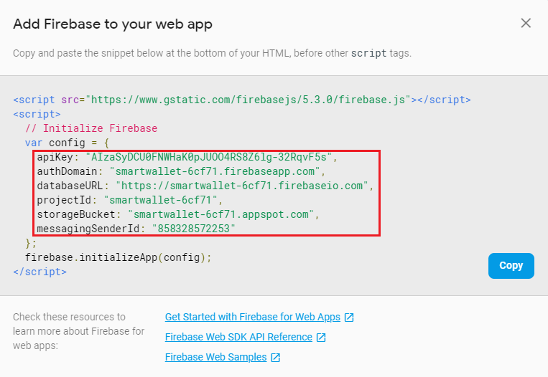
Configuration (Cont.)
Once you have created your firebase project, click on “Add Firebase to your web app”.
A dialogue box similar to this should be shown:

Slide 9
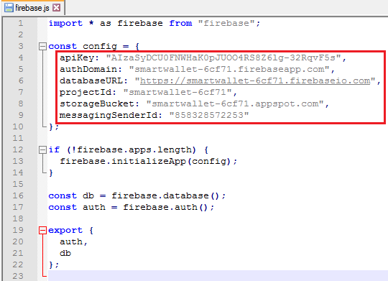
Configuration (Cont.)
Replace the firebase configuration code in \SmartWallet\src\firebase\firebase.js with the code that is shown in the dialogue box.
Firebase is now configured to run with the SmartWallet webapp.

Slide 10
Users
Can create account
Login / Google Sign-in
Use money management features

Slide 11
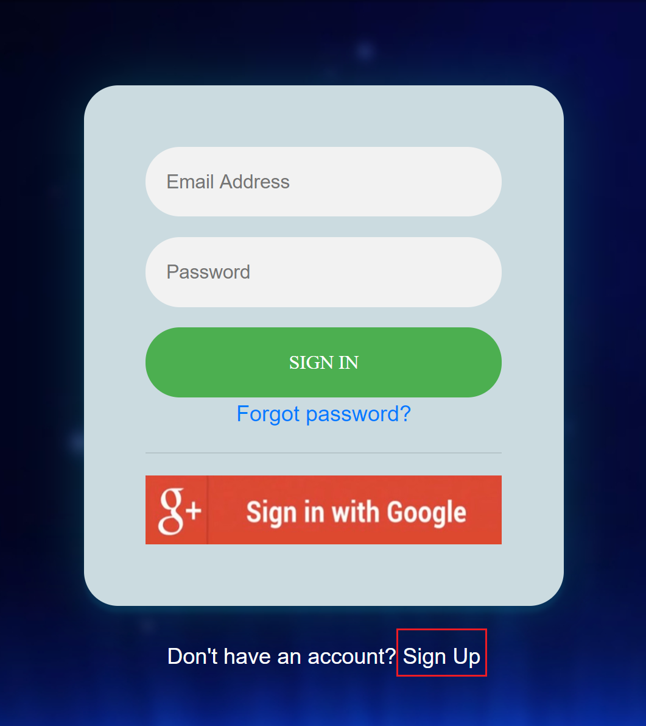
Creating an Account
Under the sign-in box, click on the “Sign Up” link.
Fill out the appropriate fields, then click on the “Sign Up” button.

Slide 12
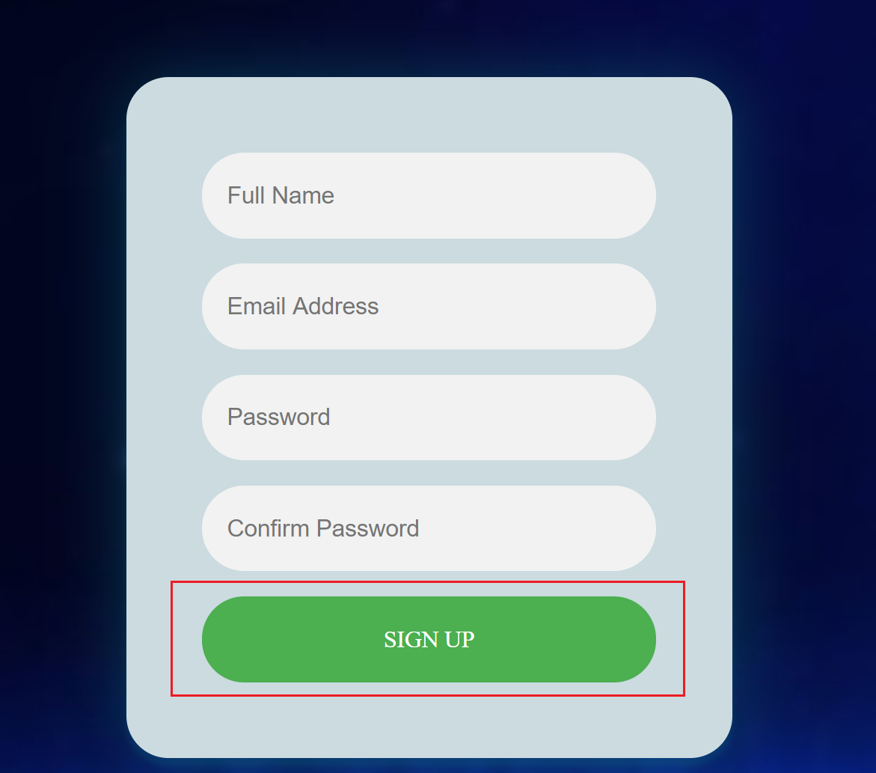
Creating an Account (Cont.)
3. Your email address and password combination has now been created.

Slide 13
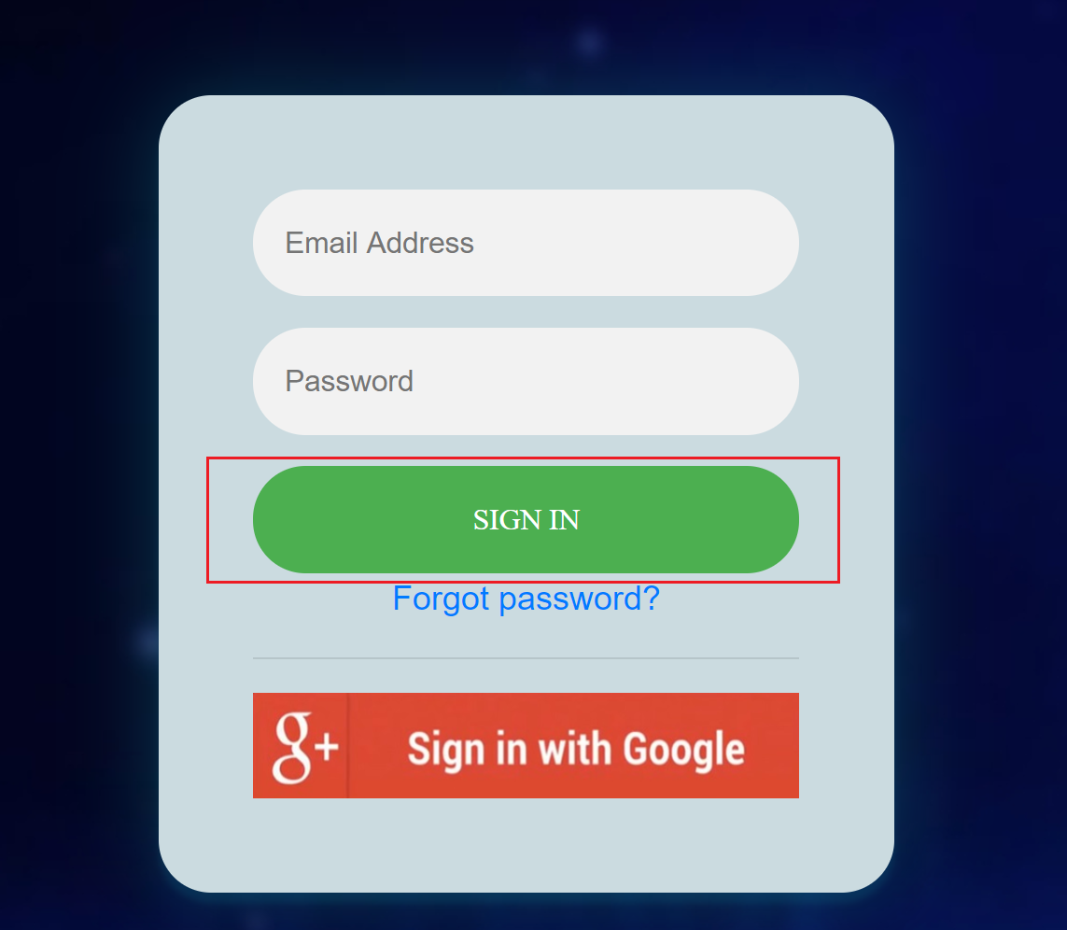
Logging In
Fill out the appropriate fields, and click the “Sign In” button.

Slide 14
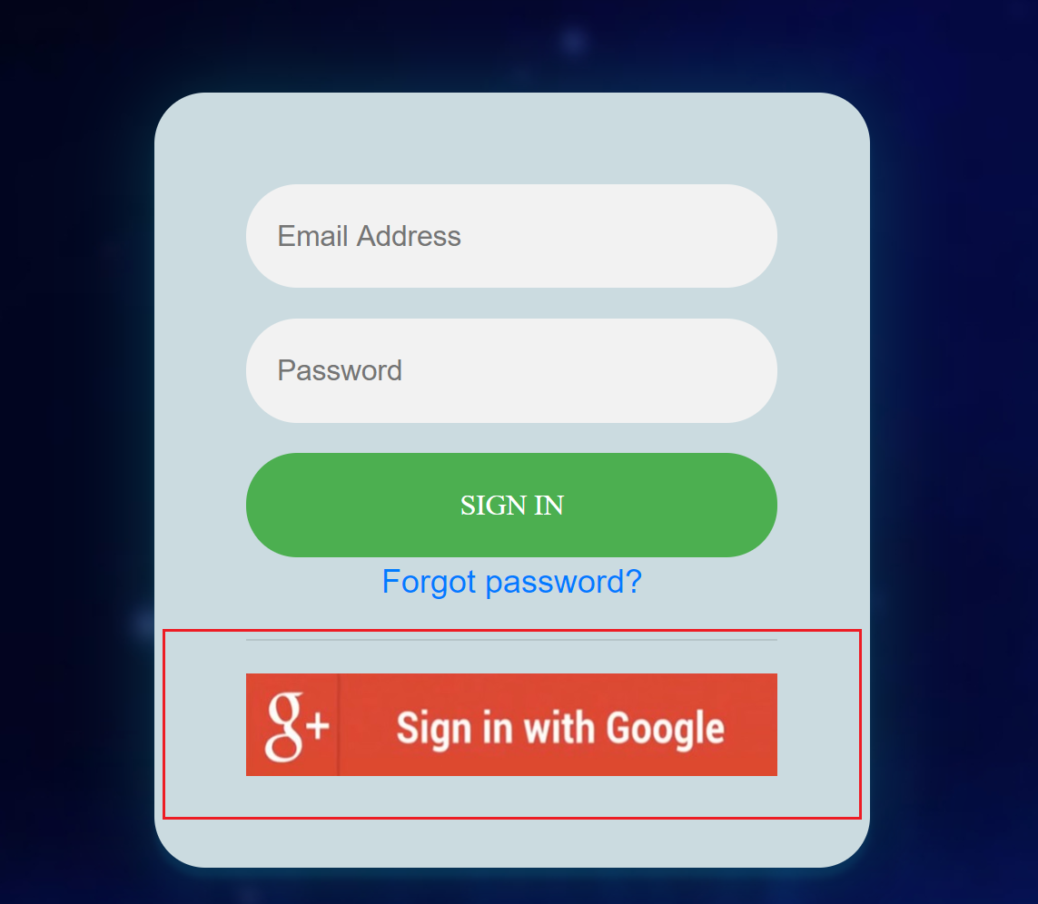
Logging In (Cont.)
2. Additionally, users can sign in using Google accounts.

Slide 15
Money Management
Features:
Overall View
Adding Expenses
Deleting Expenses
Updating Expenses
Month View
Everyday View
Filtered View
Statistics
Profile

Slide 16
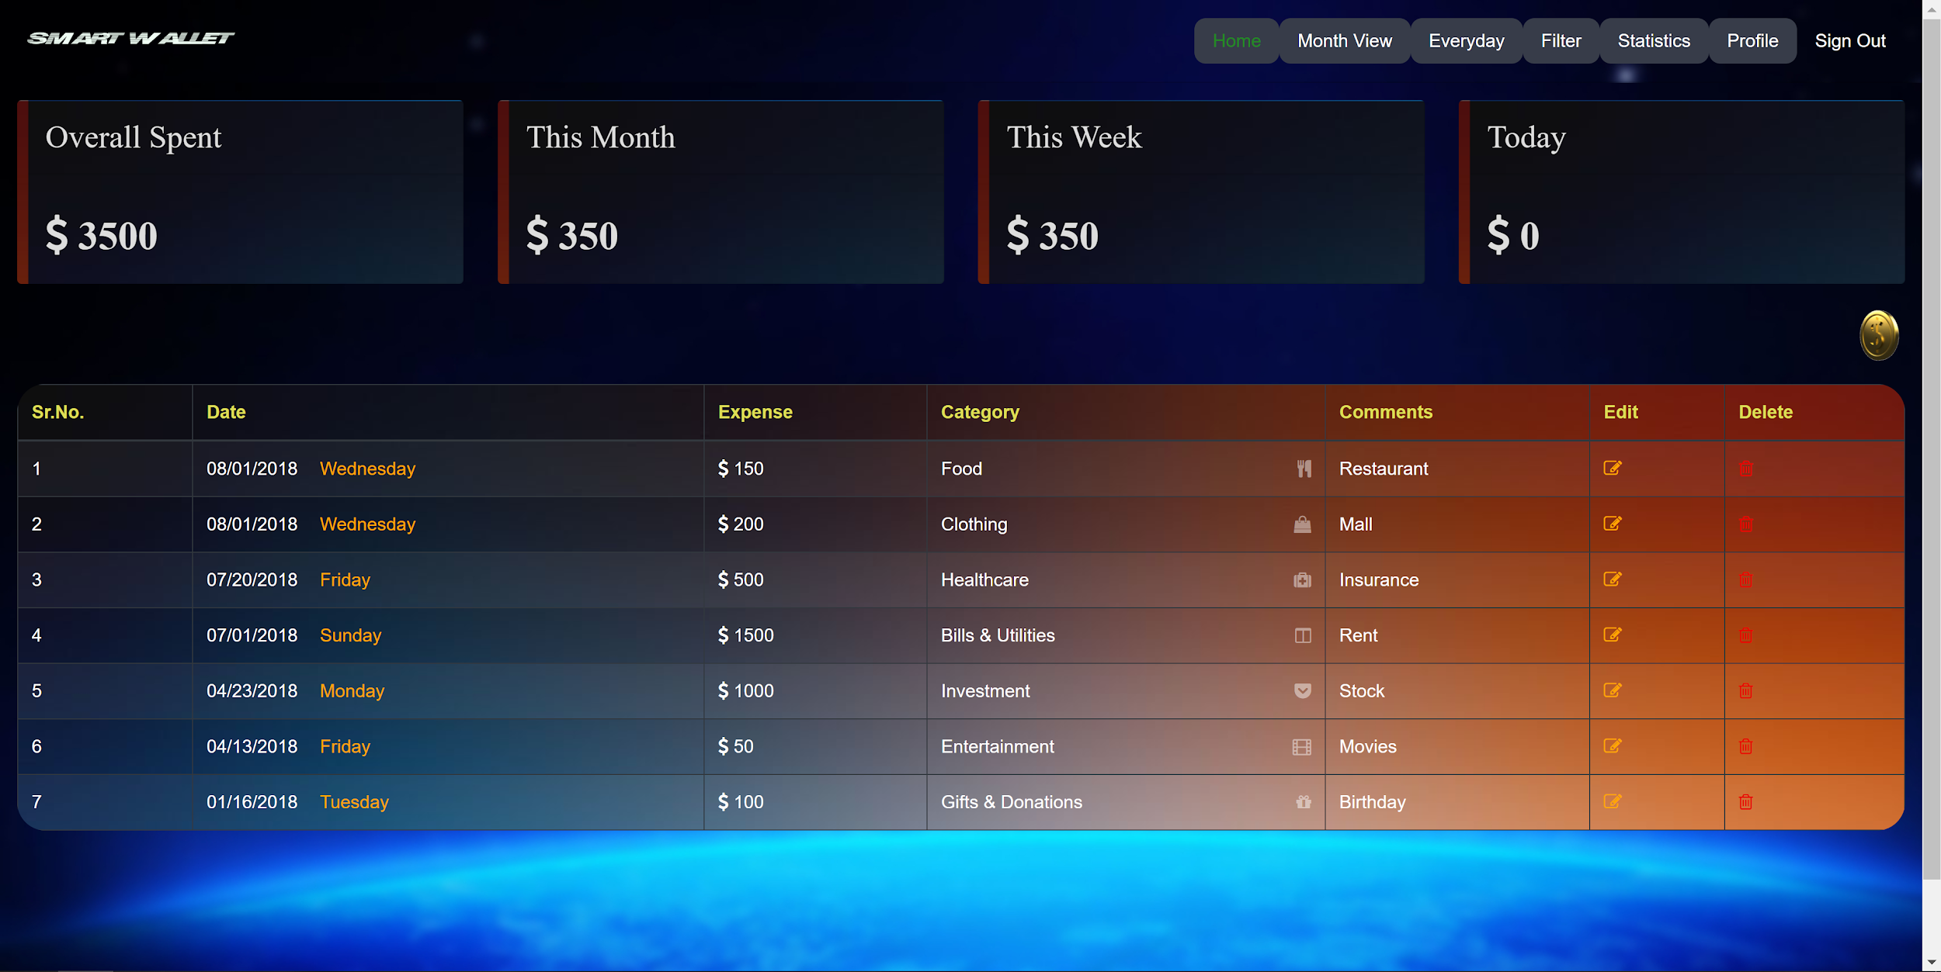
Overall View
After logging into an account, the home page should default to the overall view.

Slide 17
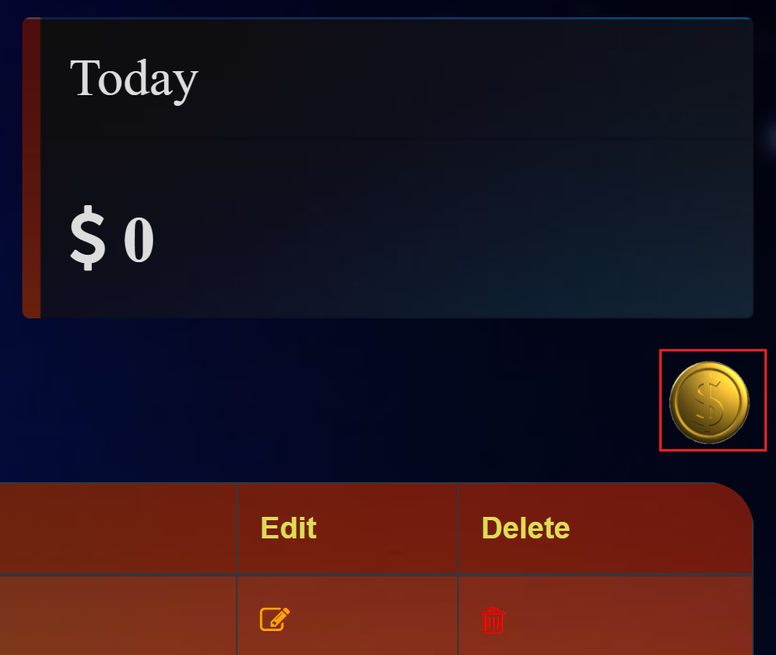
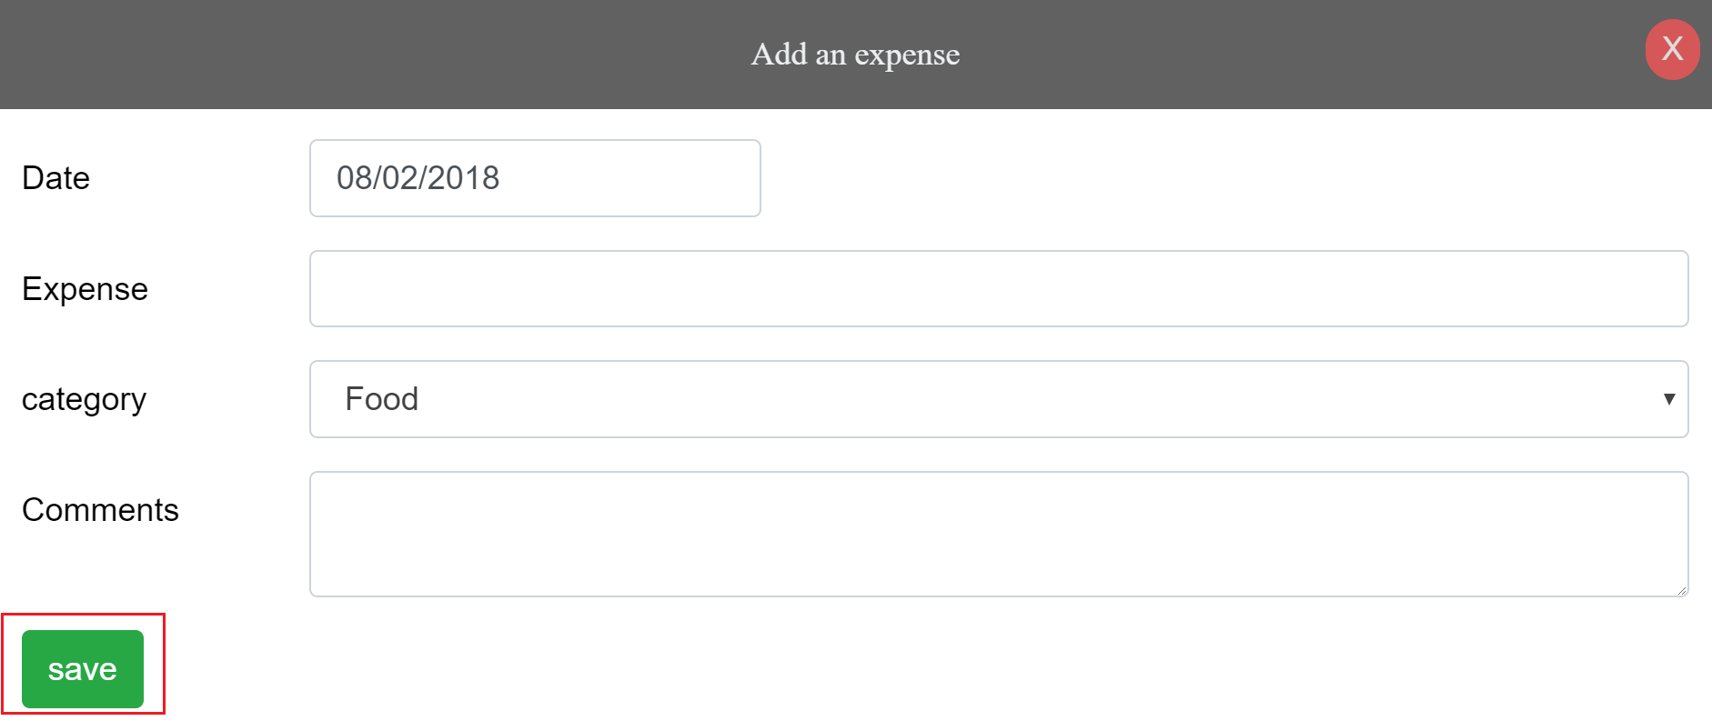
Adding Expense
Click on the spinning golden coin just above the chart to add an expense.
Choose a date, input expense, choose a category, and enter a comment/description

Slide 18
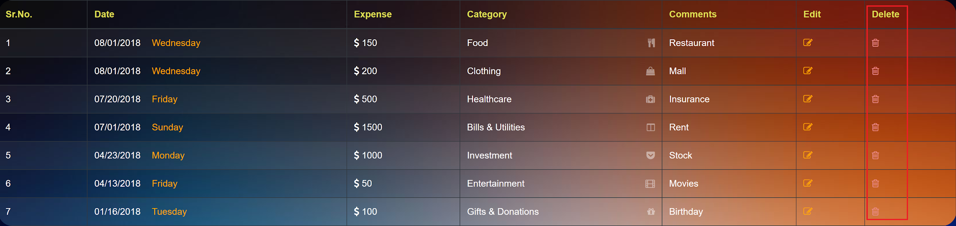
Deleting Expense
Under the delete column for the expenses table, select the trash icon that corresponds to the specific expense to be deleted.

Slide 19
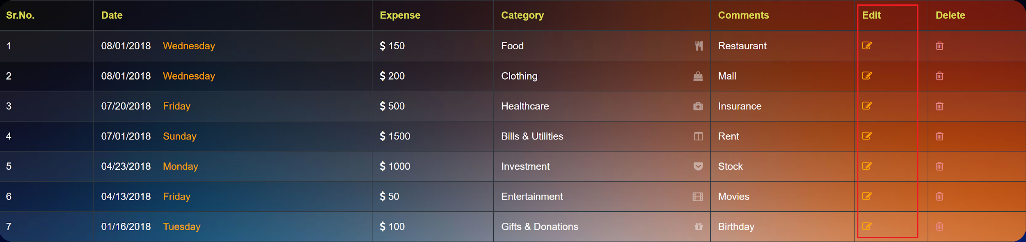
Editing Expense
Under the edit column for the expenses table, select the notepad/pencil icon that corresponds to the specific expense to be edited.
In the popup window, edit the relevant fields and click the “Save” button.

Slide 20
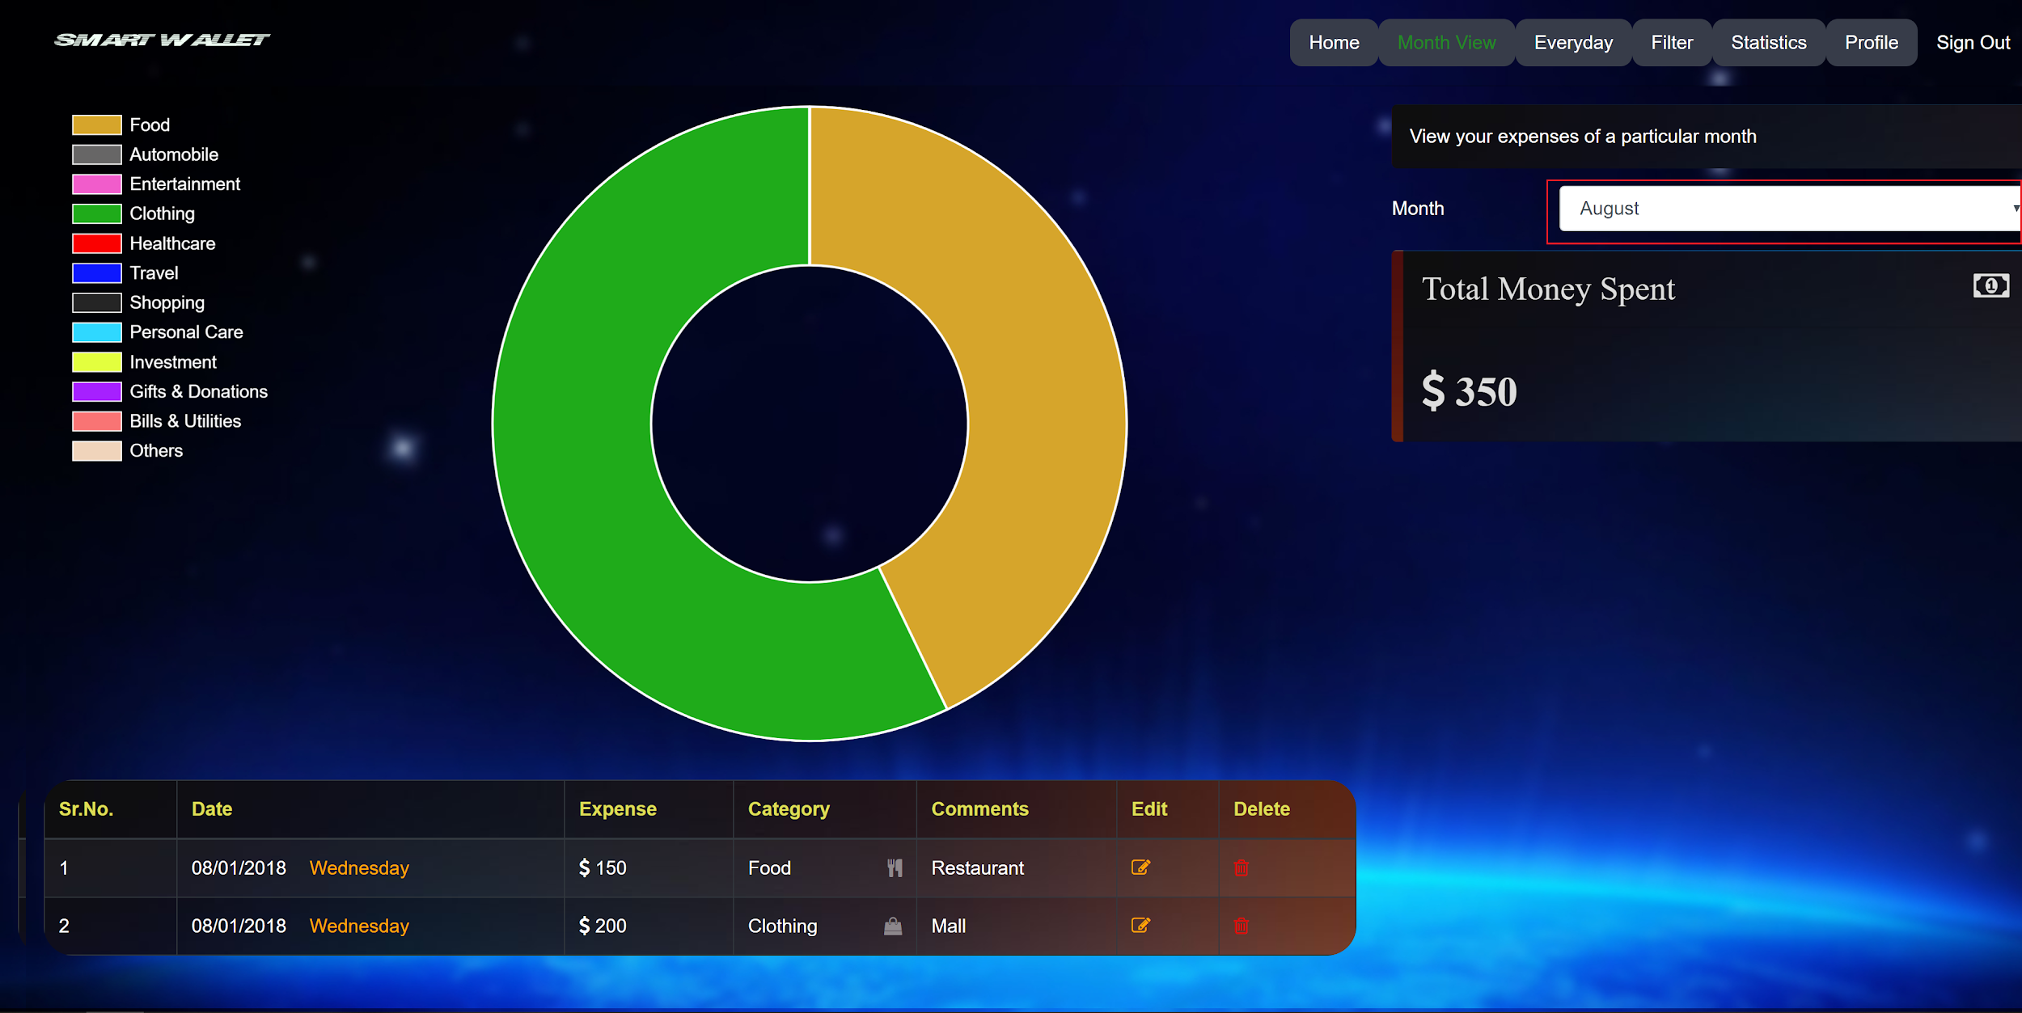
Month View
In the top right corner of the page, click on the “Month View” tab.
Choose the month to view the expenses and details in a pie chart representation.

Slide 21
Everyday View
In the top right corner of the page, click on the “Everyday” tab.
Select a date to view the expenses and details in a pie chart representation.

Slide 22
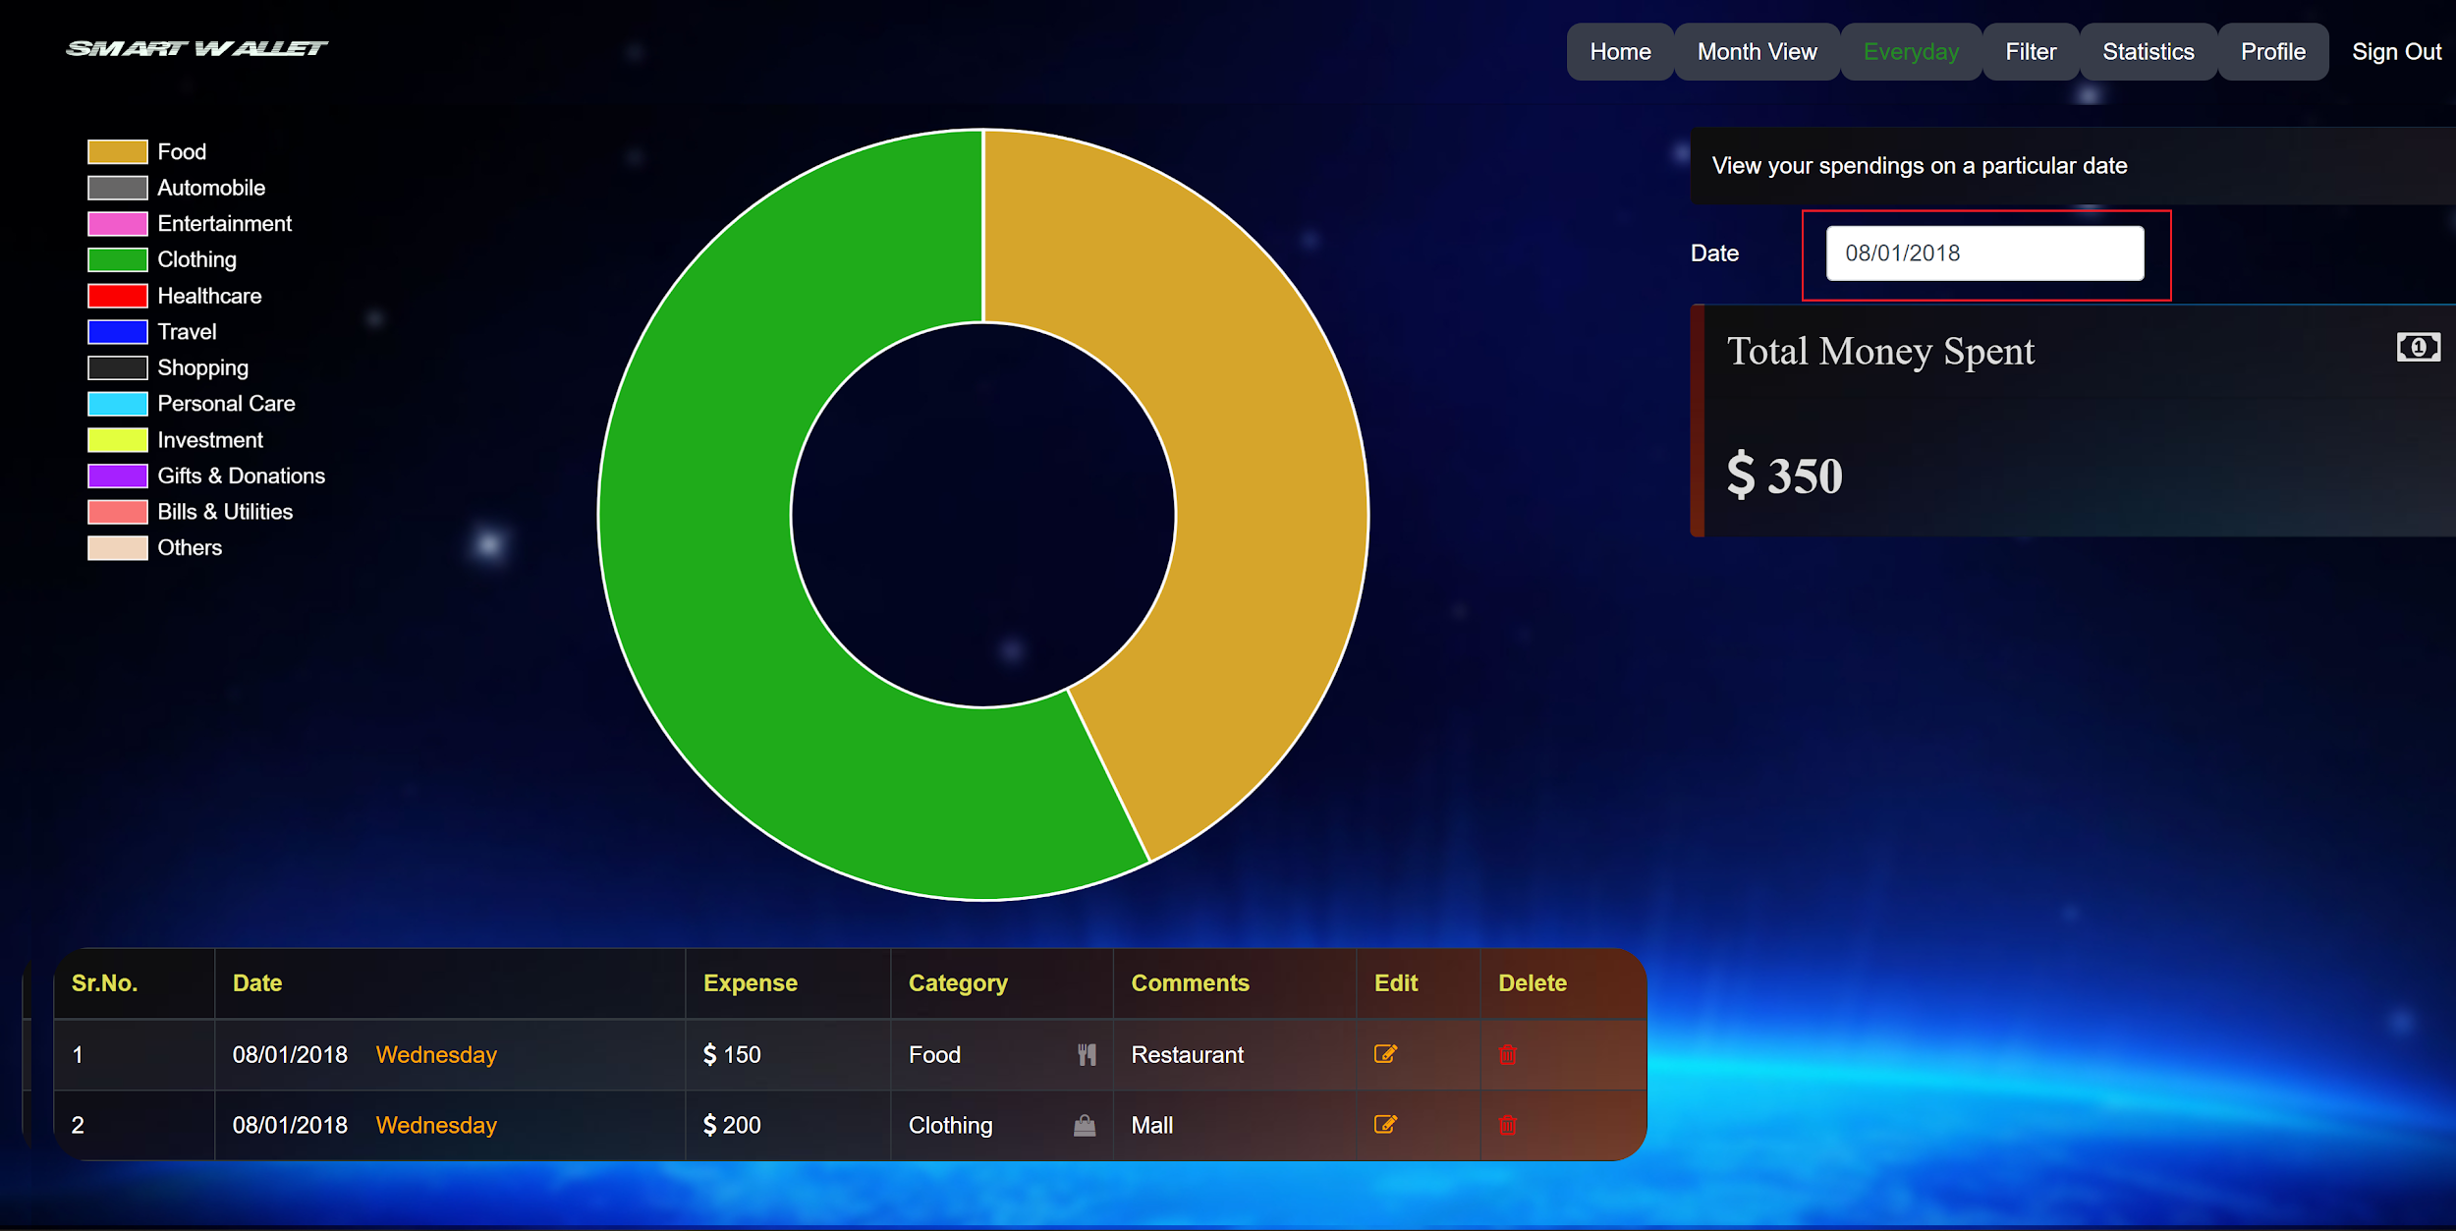
Everyday View (Cont.)

Slide 23
Filter View
In the top right corner of the page, click on the “Filter” tab.
Filter expenses by a combination of date, expenses, and category.

Slide 24
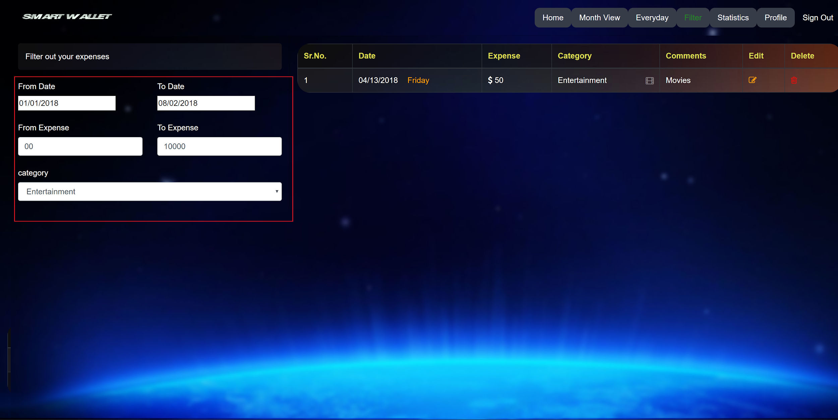
Filter View (Cont.)

Slide 25
Statistics
In the top right corner of the page, click on the “Statistics” tab.
A bar graph detailing the total monthly expenses for the year and a pie graph detailing the total expenses for each category will be shown.

Slide 26
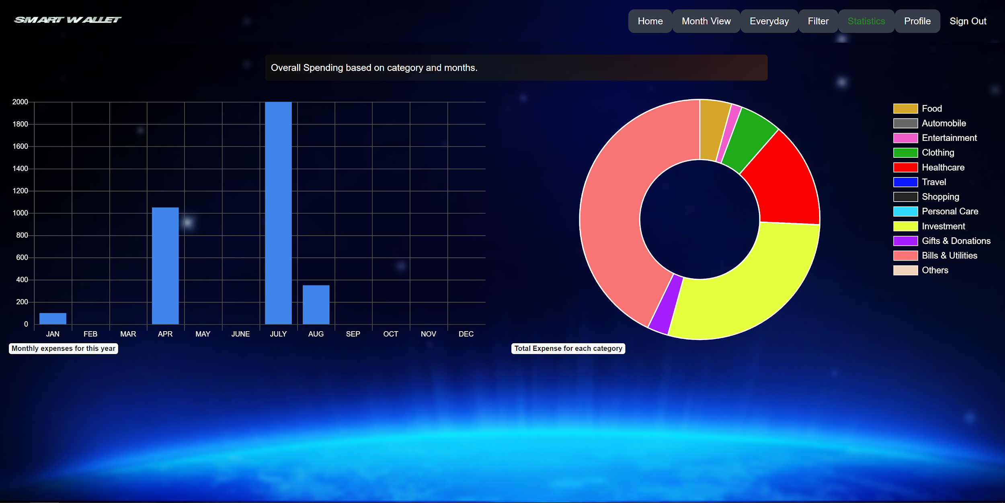
Statistics (Cont.)

Slide 27
DEMO
A demo will be shown now.

Slide 28
Future Features
Budget
Credit Card / Bank Account Sync
Theme Changing (Day/Night Mode)
Export Excel
Predictive Cost Analysis

Slide 29
The End
Any Questions or comments?

